Slide 1
Refinement and Visualization of Connectivity Map Query Results
September 25, 2013

Slide 2
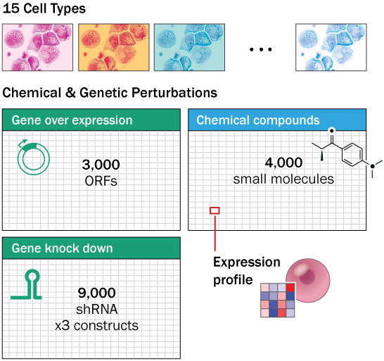
Connectivity Map (CMap) Concept
cultured cells perturbed with various genetic and chemical reagents
gene expression profiles collected
lookup table for functional hypothesis generation
query with a signature and ask what is similar/dissimilar
Notes:
PC3 HA1E MCF7 HCC515 VCAP A375 HEPG2 HT29 A549 ASC NPC NEU PHH SKB HEK293T

Slide 3
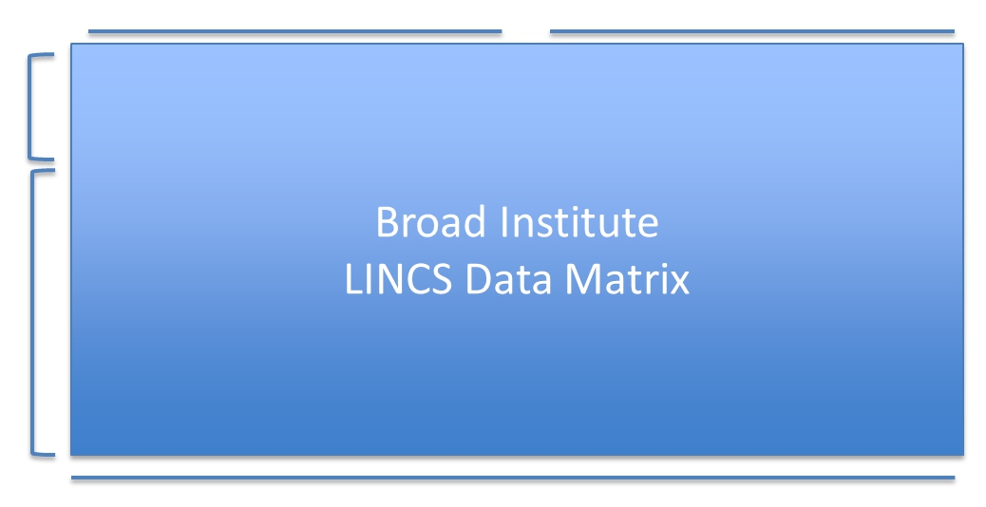
Current CMap Dataset
small-molecules
genomic perturbagens
1,000 landmark genes
over 400,000 signatures
21,000 inferred genes
5,178 compounds
1,300 off-patent FDA-approved drugs
700 bioactive tool compounds
2,000+ screening hits (MLPCN + others)
3,712 genes (shRNA + cDNA)
targets/pathways of FDA-approved drugs (n=900)
candidate disease genes (n=600)
community nominations (n=500+)
15 cell types
Banked primary cell types
Cancer cell lines
Primary hTERT-immortalized
Patient-derived iPS cells
5 community nominated

Slide 4
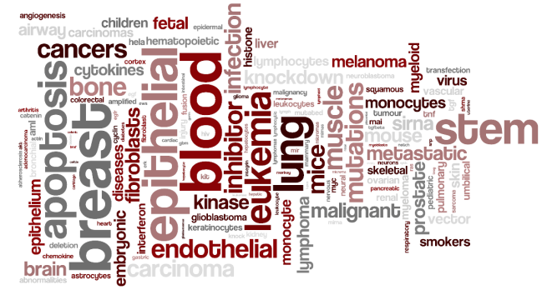
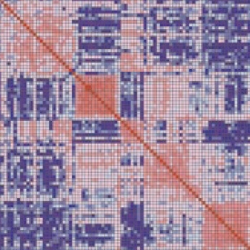
Landmark genes
expression of 978 landmark genes measured
selected from large, diverse, high-quality microarray dataset
orthogonal expression and validated predictive power
inputs for genome-wide inference model
compute expression of transcripts not explicitly measured
flagged as LM (rather than INF) in output data file
>100,000 Affy U133 scans
gene × gene correlation
landmarks

Slide 5
The problem
Size of dataset yields very long hit lists - difficult to prioritize
Even taking top 0.1% of connections yields hundreds of hits
Need to refine hit lists into more actionable size

Slide 6
Proposed solution: identify biological “themes” within hit list
Prioritize subsets of hits based on their interconnectivity
Is the hit list generally connected to itself?
Are any clusters present?
Visualize as a highlighted graph
Word cloud of associated terms

Slide 7
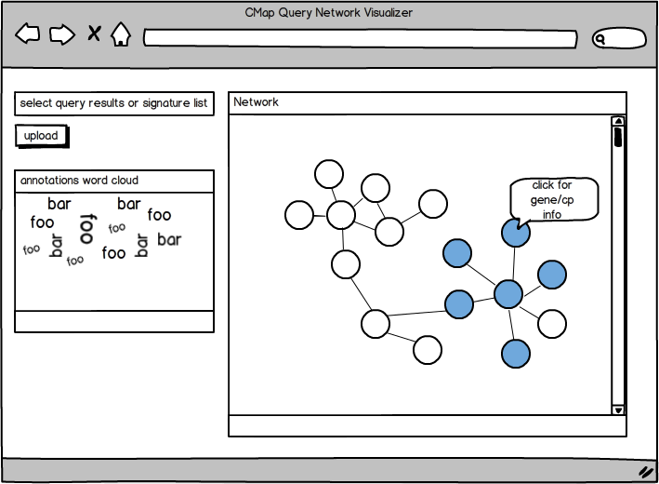
A web application
user uploads list of signatures or query results
application visualizes and highlights them in graphical context within entire space of connections
computes:
their interconnectivity
number of clusters
word cloud of associated terms

Slide 8
Previous work
Graphical models used frequently in other biological contexts:
gene regulation, protein interaction, etc.
Other approaches to refine hit lists:
summly: algorithm for collapsing query results across cell lines to yield reagent-centric hit lists
gold signature designation: compute subspace of signatures whose quality metrics exceed some thresholds
consensus signatures: collapse shRNA signatures by those that target same gene
other refinement approaches not yet published

Slide 9
Potential challenges
Compute within the browser:
visualizing large graph
view only subset
edge bundling / fish eye zoom
computing hit list interconnectivity
pre-compute/offload to backend server
computing clusters
pre-compute/offload to backend server

Slide 10
technical details

Slide 11
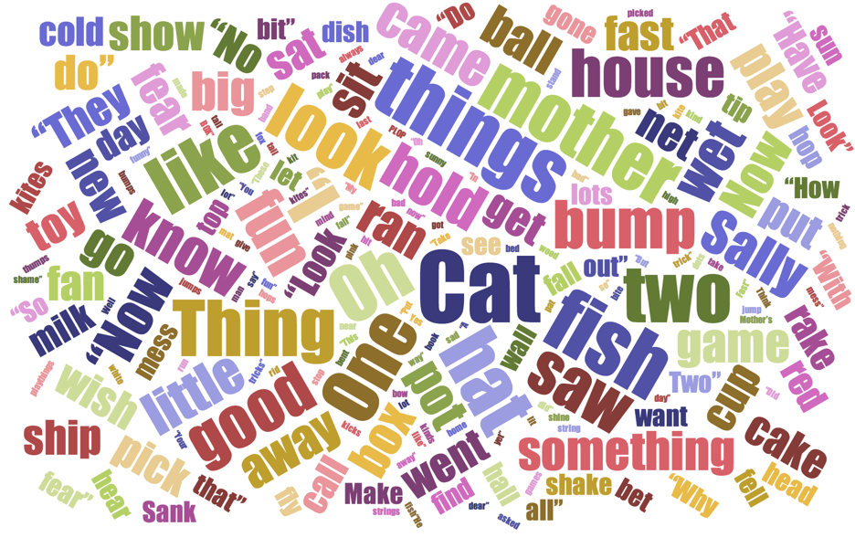
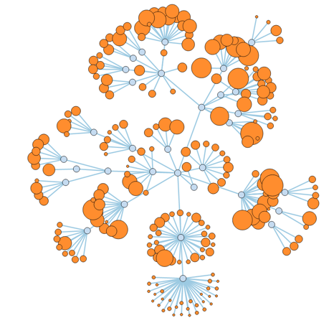
Front end: D3 JavaScript library
capable of word cloud and graph visualizations
http://d3js.org/

Slide 12

Back end: MongoDB database
Non-relational database
JSON format
Will store:
pre-computed connectivity scores
signature annotations
www.mongodb.org

